Slide 1
ESS 118 Final Presentation: The effect of rising surface air temperature on evapotranspiration rate and soil moisture content
by Suvam Patel

Slide 2
Data
Used my datasets from the Australian Climate Community and Earth System Simulation (ACCESS) from CMIP6
The experiment ID used is historical and ssp370 which charts a timeline from 1850 to 2100.
Variables used are tas (surface air temperature), evspsbl (evapotranspiration rate), mrso (soil moisture content), and areacella

Slide 3
Hypothesis
For my project I have decided to analyze the effects of surface air temperature on evapotranspiration rate and soil moisture. I am using my data from ACCESS_ESM1-5 which is an Australian model.
Due to an increase in human energy consumption, global warming has been on an all time rise. Such an increase in temperature will have adverse affects on evapotranspiration rate and soil moistur.
My prediction is that increasing surface air temperature will cause an increase in evapotranspiration rates globally, which in turn will cause a decrease in soil moisture content.

Slide 4
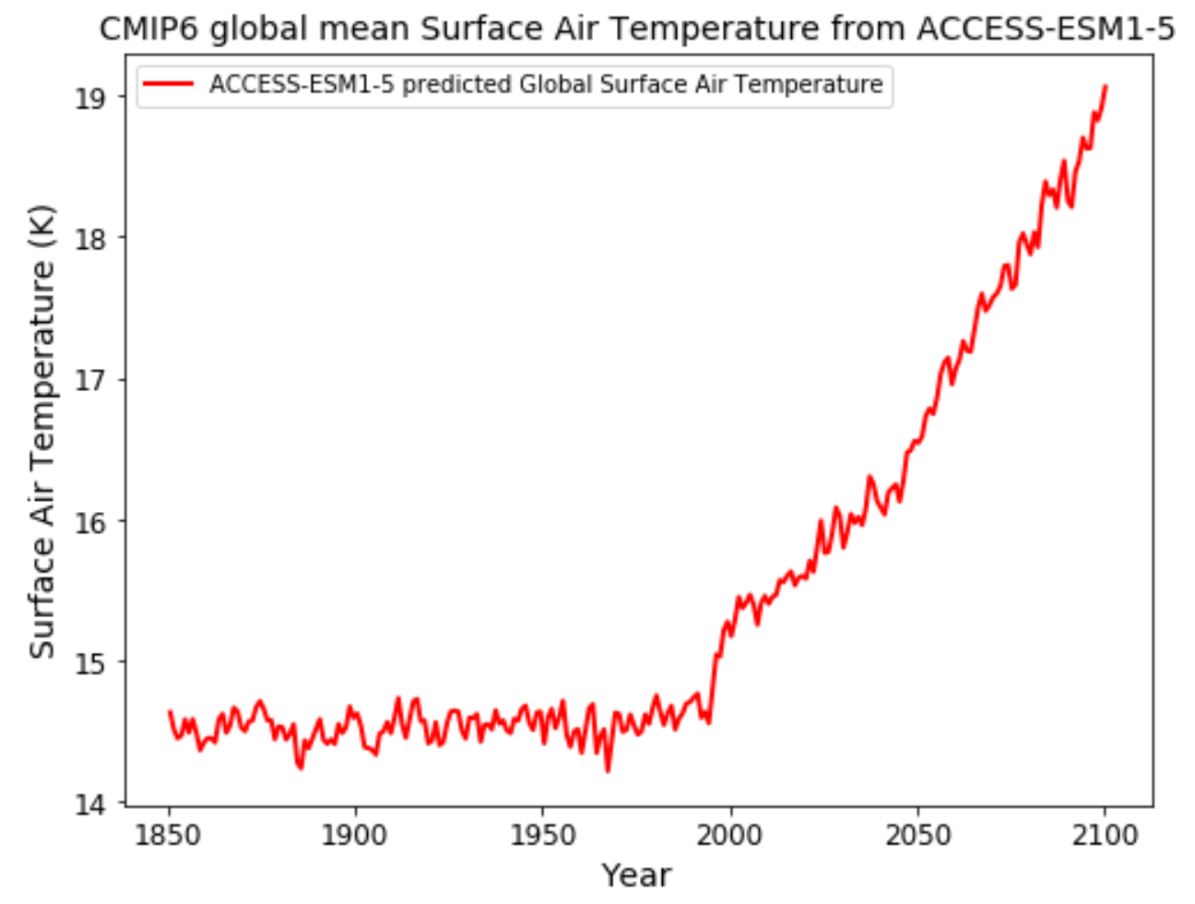
Results: Timeseries for Surface Air Temperature

Slide 5
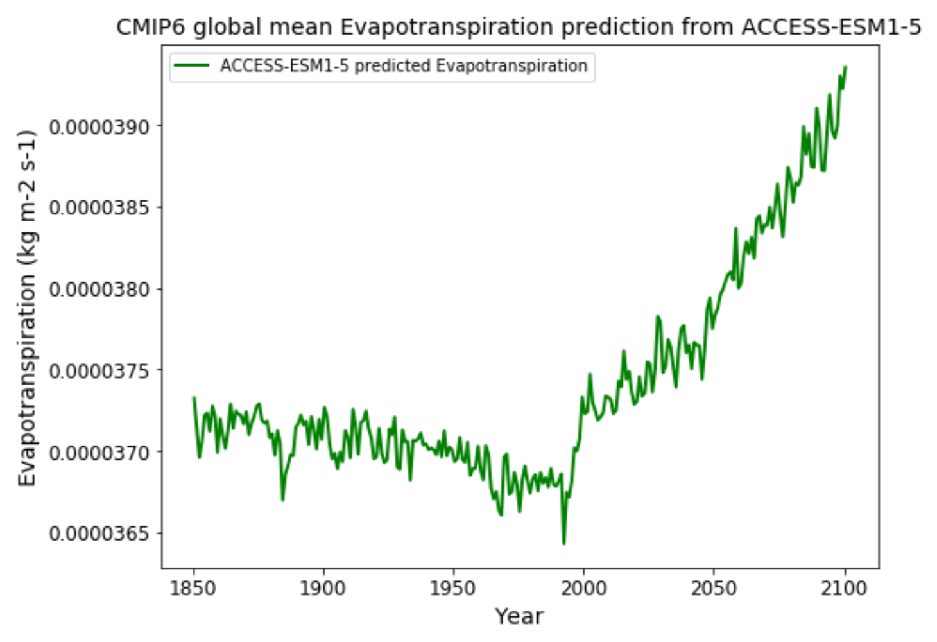
Results: Timeseries for Evapotranspiration Rate

Slide 6
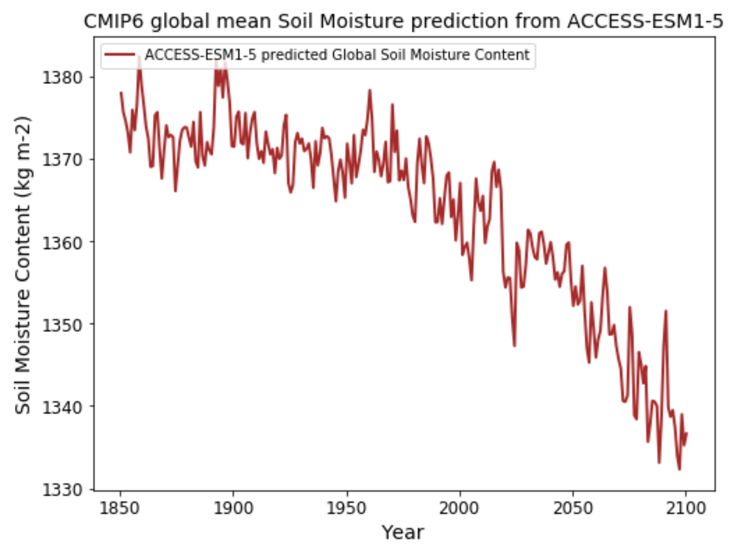
Results: Timeseries for Soil Moisture Content

Slide 7
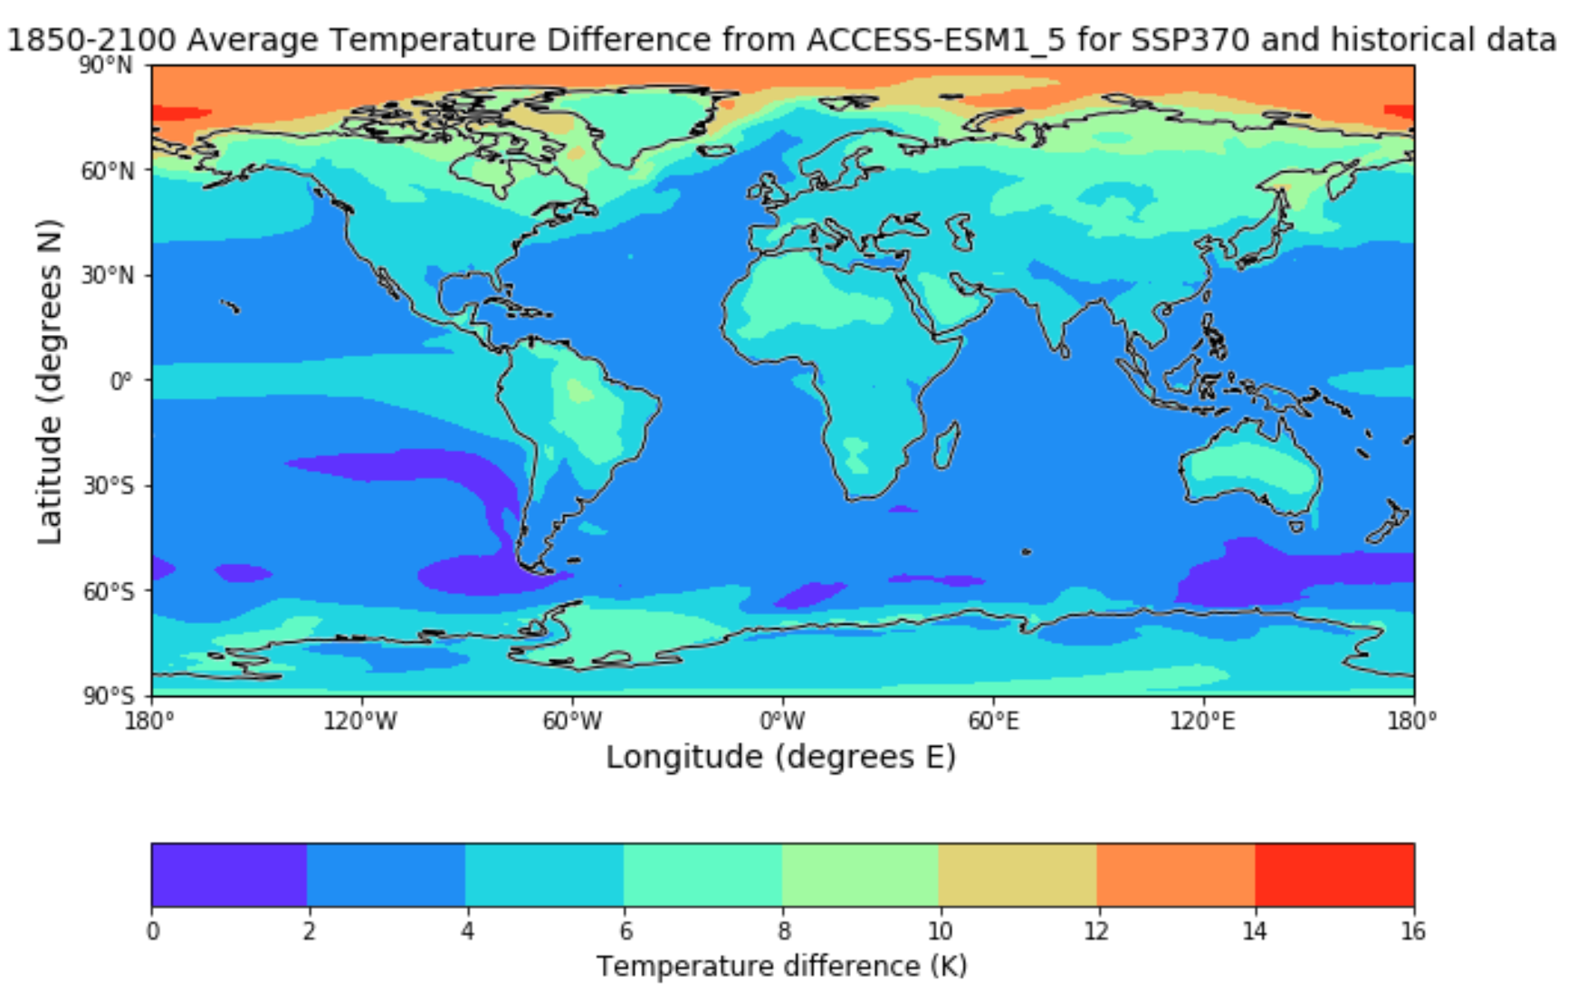
Surface Air Temperature Difference

Slide 8
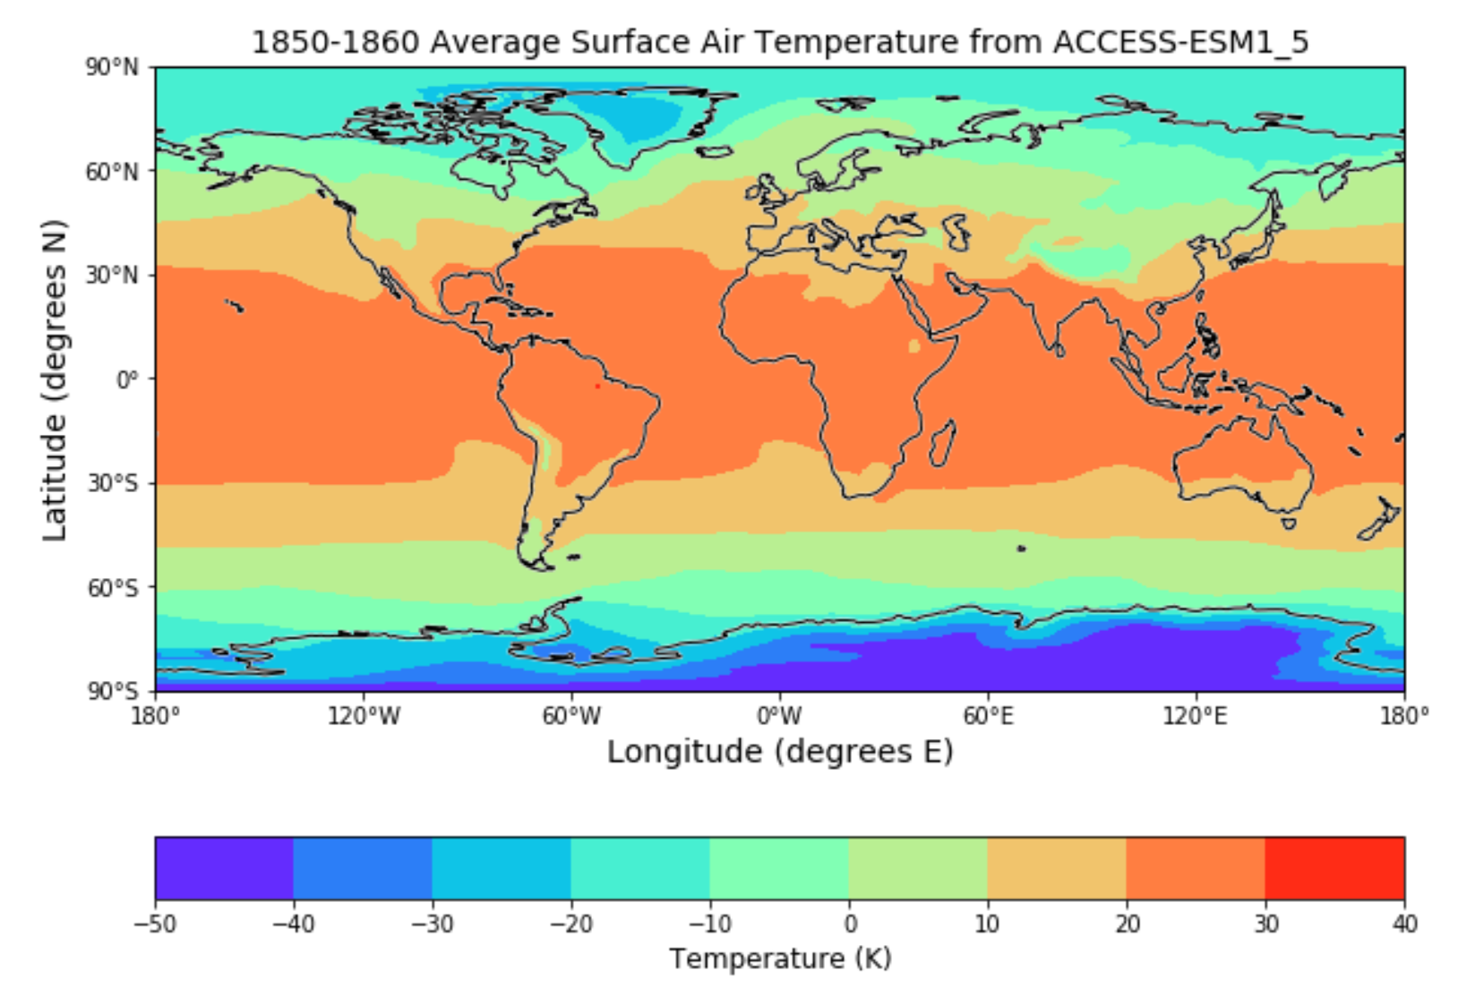
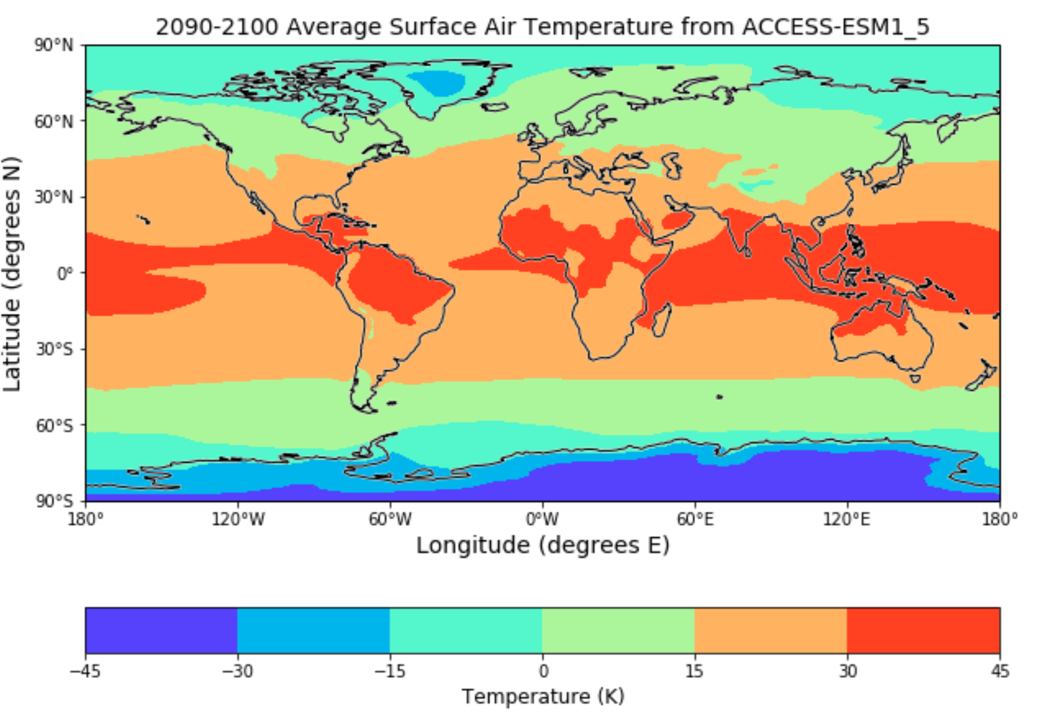
Surface Air Temperature Difference (Contd)

Slide 9
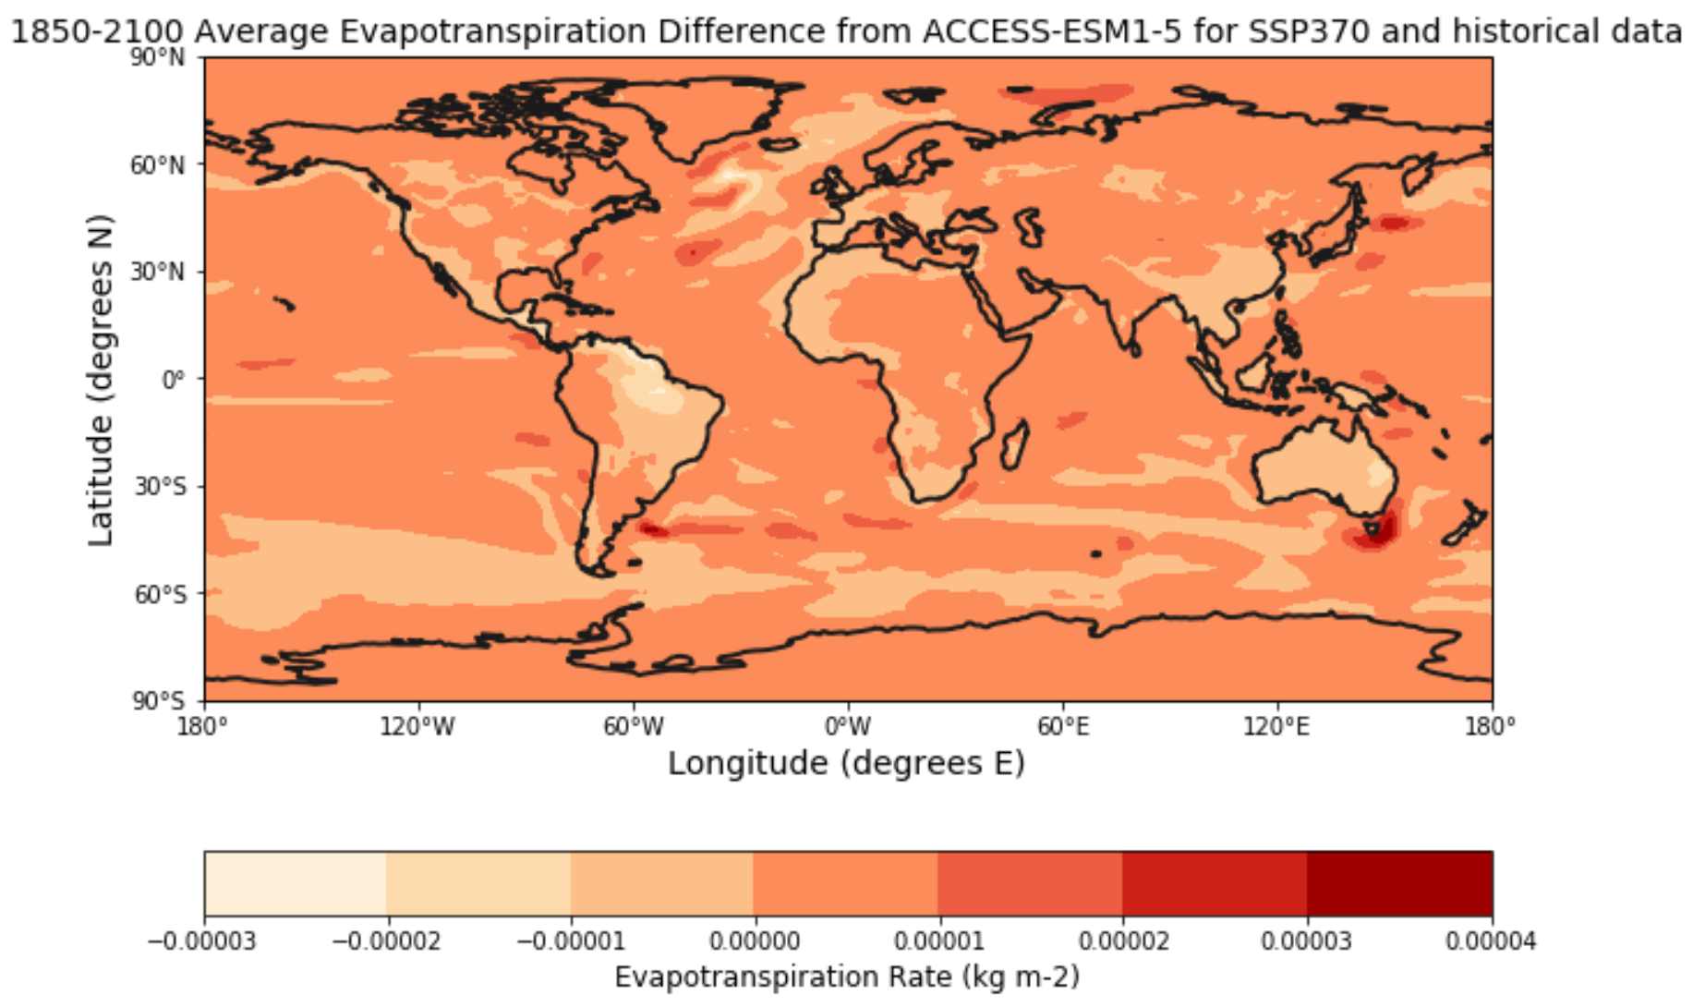
Evapotranspiration Rate Difference

Slide 10
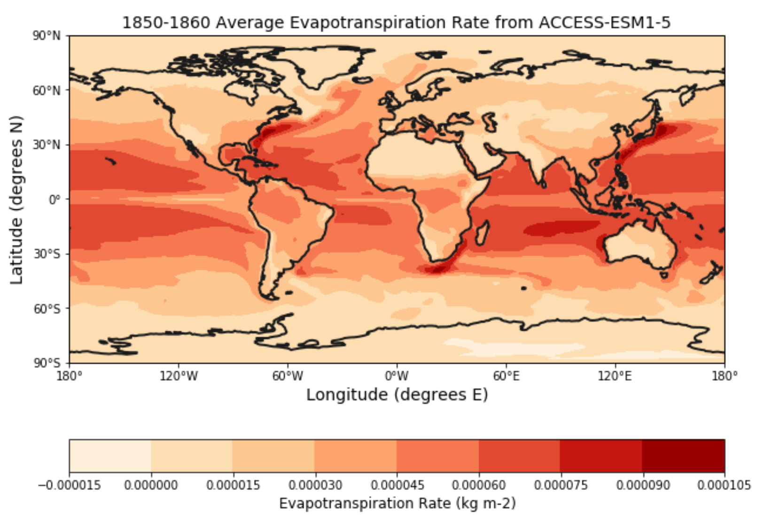

Evapotranspiration Rate Difference (Contd)

Slide 11
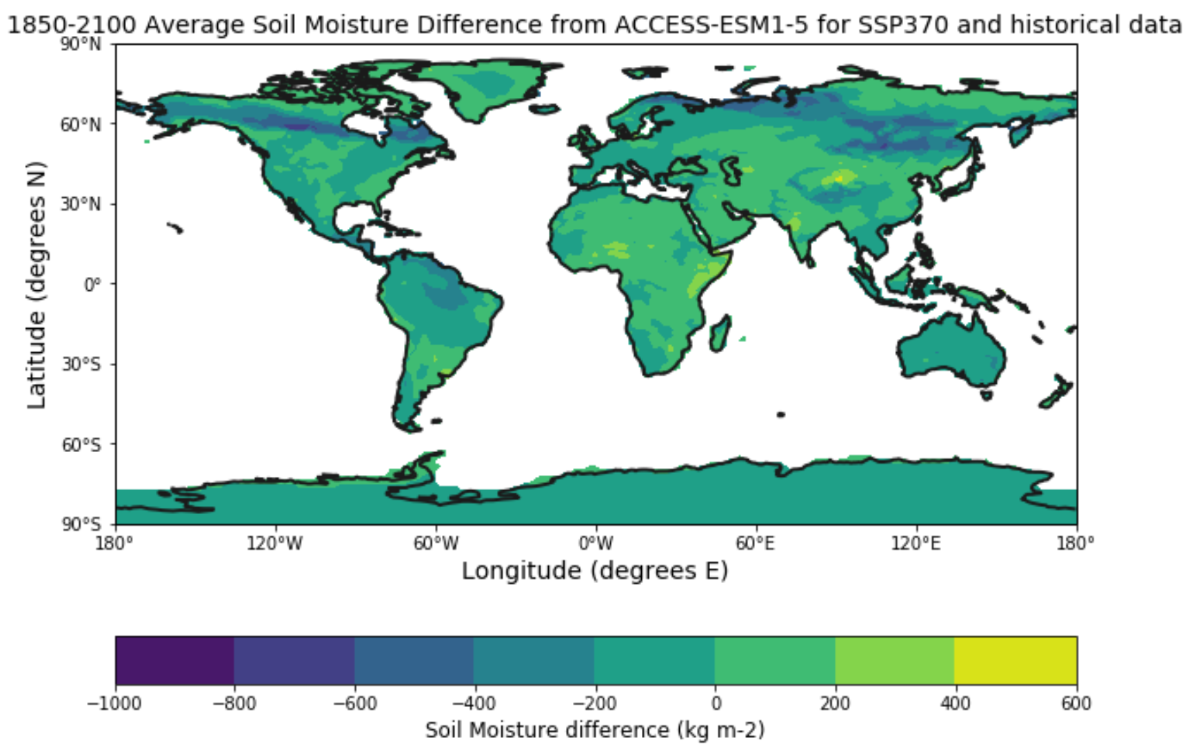
Soil Moisture Content Difference

Slide 12
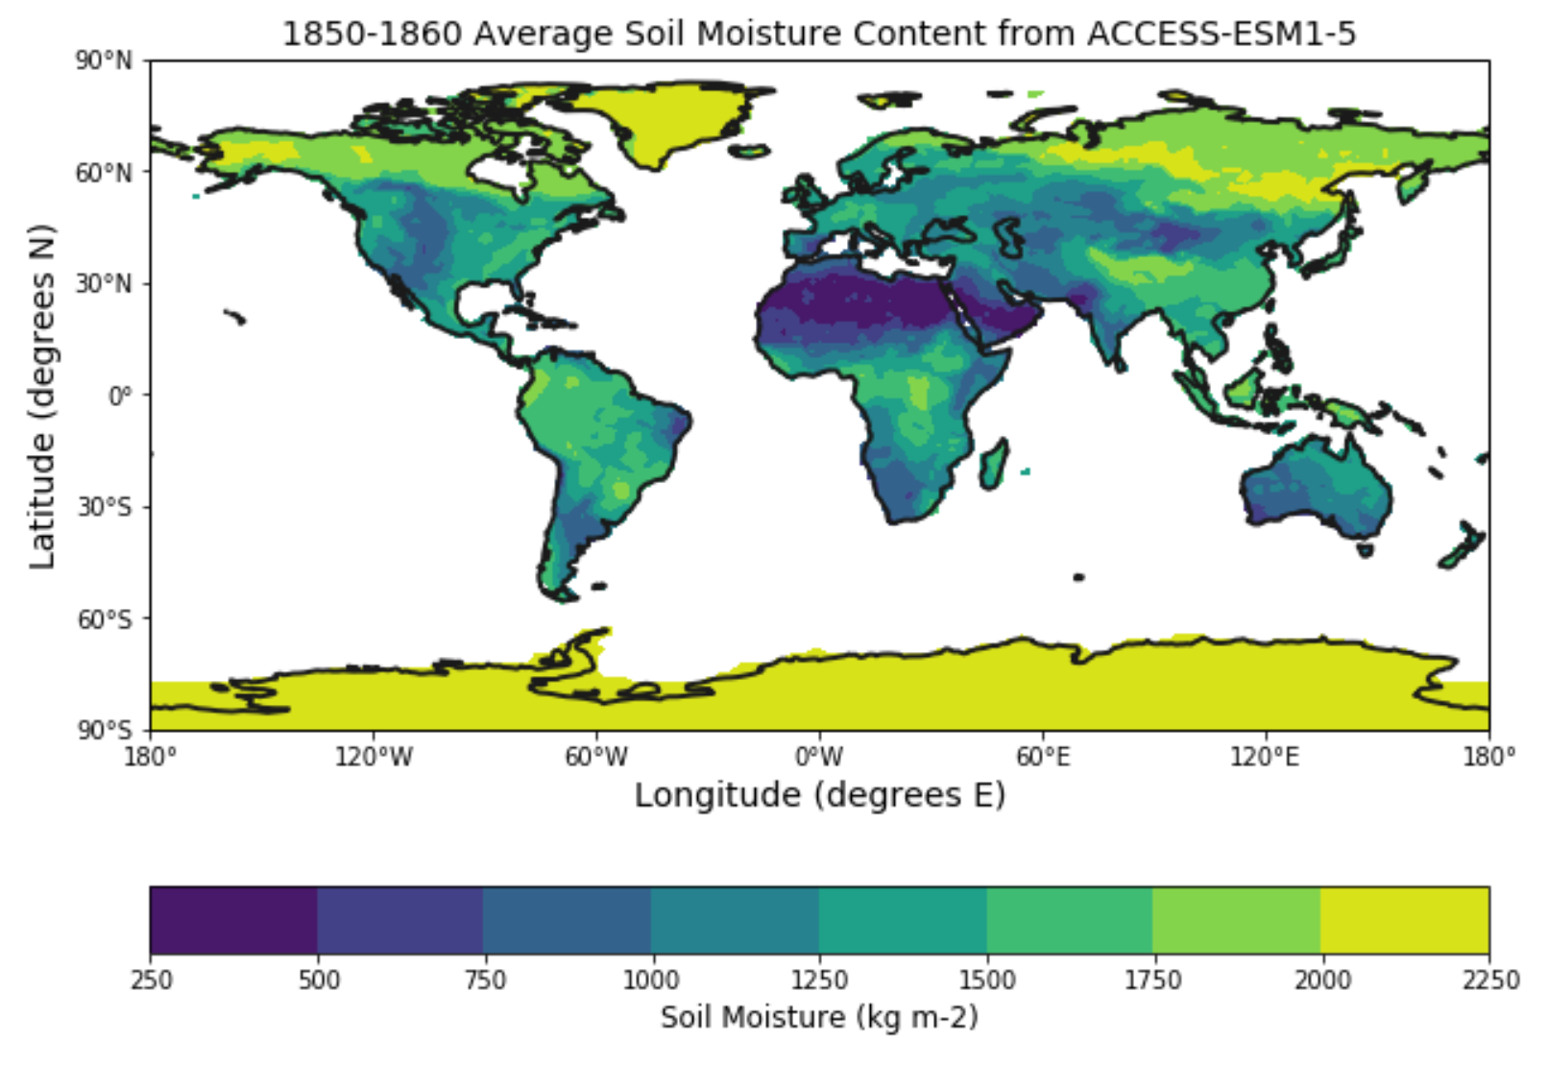
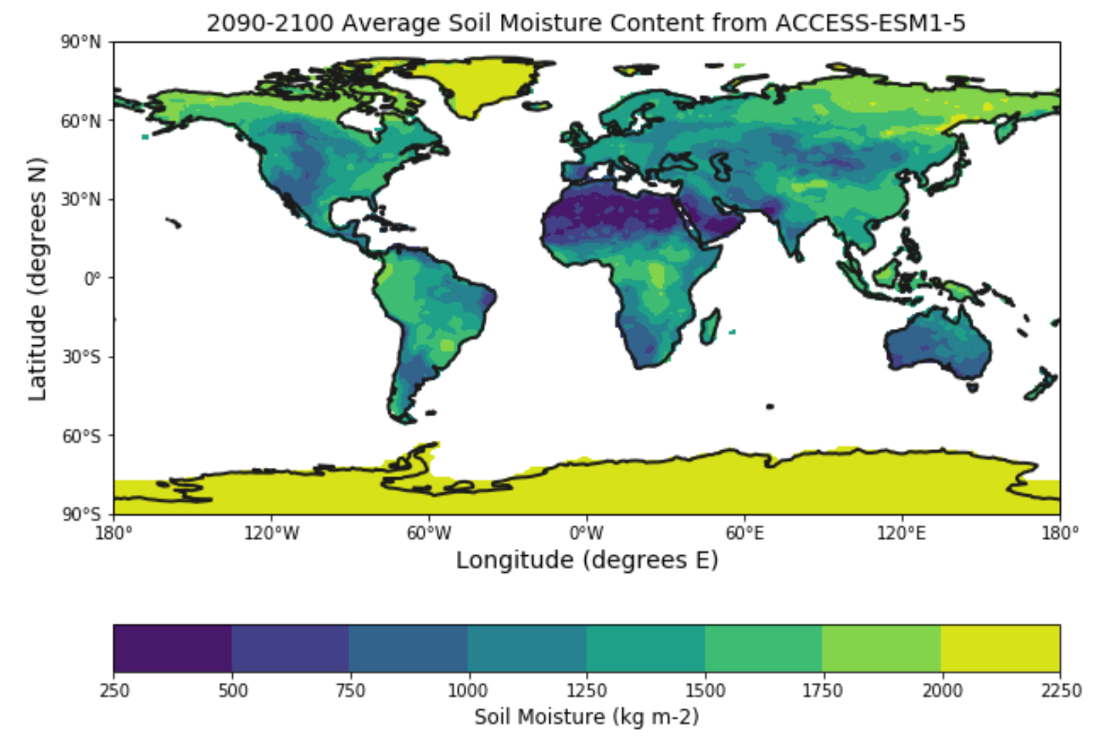
Soil Moisture Difference (Contd)

Slide 13
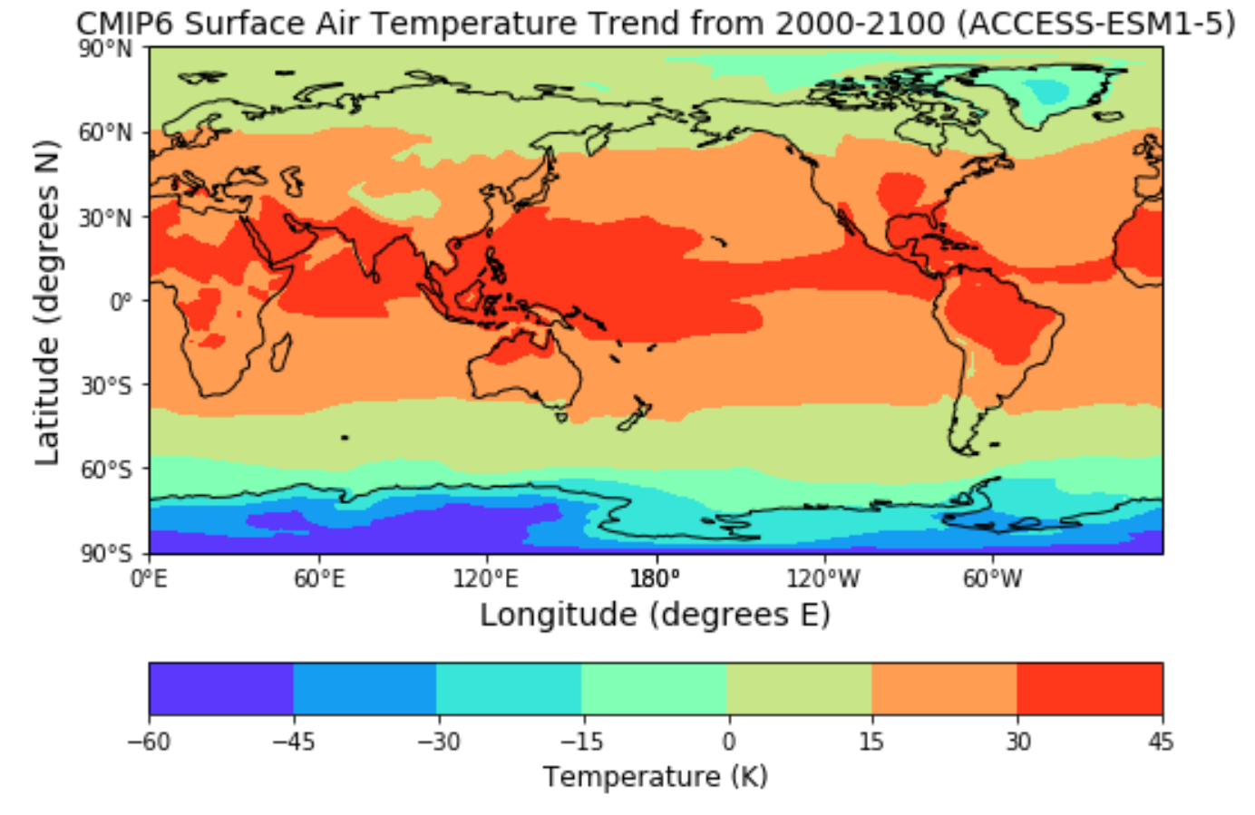
Surface Air Temperature Trend (2000-2100)

Slide 14
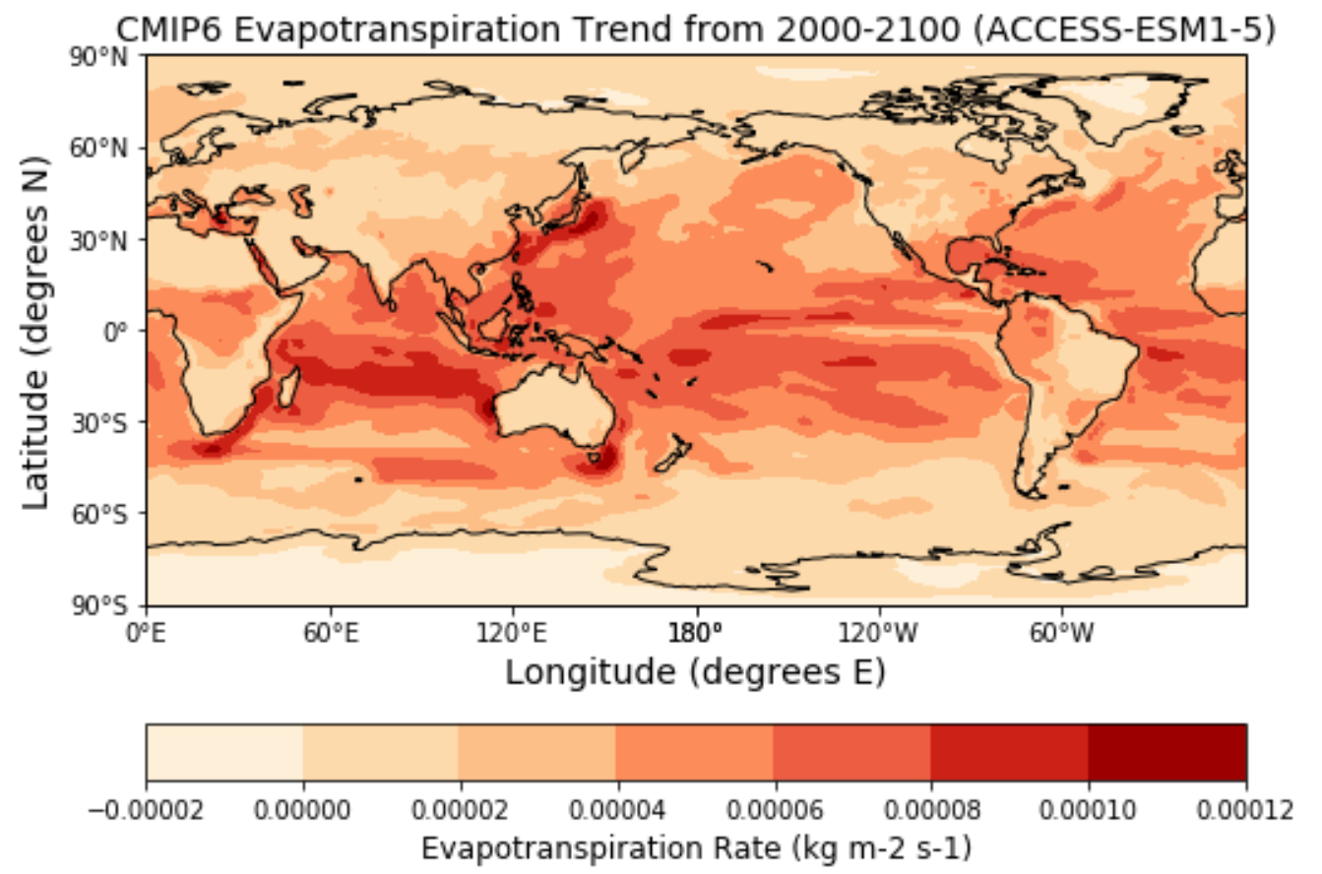
Evapotranspiration Trend (2000-2100)

Slide 15
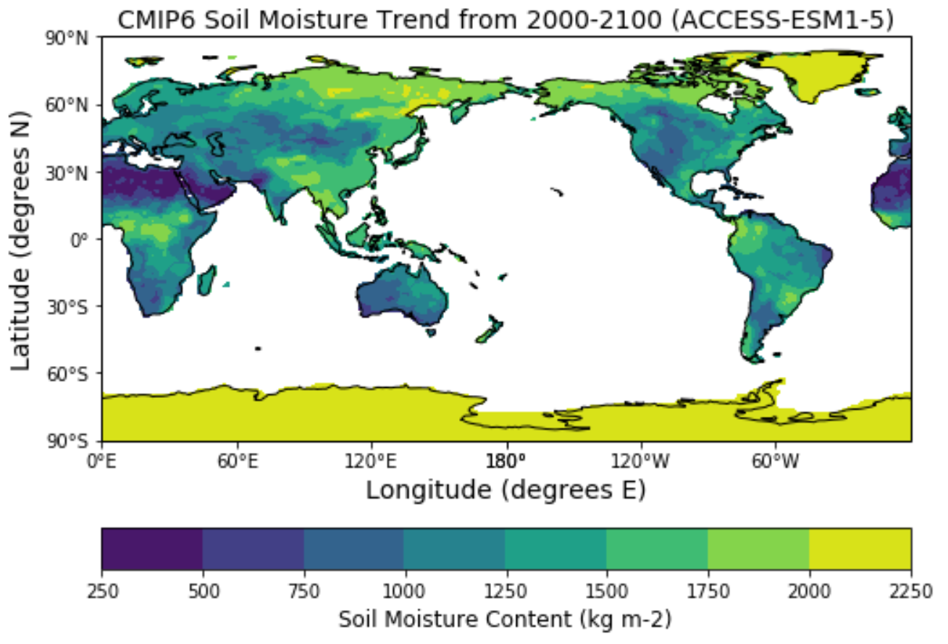
Soil Moisture Trend (2000-2100)

Slide 16
Results
Surface air temperature has been on an all time rise. Analysis shows that areas closer to the equator will experience much hotter climates. Areas mainly affected by such conditions will be South America, Central America, Central Africa, Southeast Asia, and Northwest Australia.
Increase on surface air temperature has a correlation on evapotranspiration rates. Much of the increase is shown in the ocean when compared to land. All the continents experienced higher evapotranspiration rates in some areas.
Both variables impact soil moisture content. Density of soil moisture decreases in all countries. Africa experiences the most soil moisture loss as a result of global warming. No changes are observed in Antarctica.

Slide 17
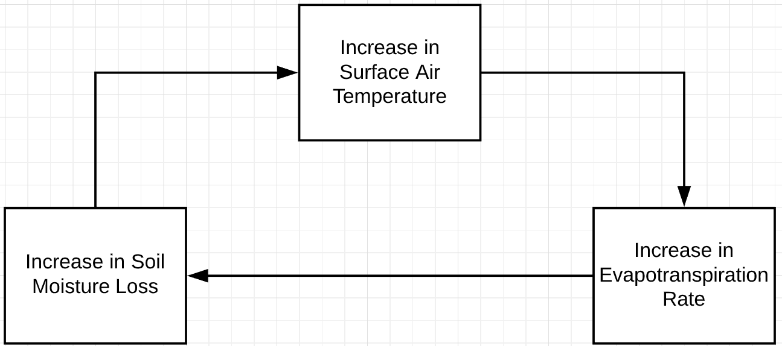
Positive Feedback Loop

